Slide 1
Normal Probability Distributions

Slide 2
Agenda
Introduction to Normal Distributions and the Standard Normal Distribution
Normal Distributions: Finding Probabilities
Normal Distributions: Finding Values
Sampling Distributions and the Central Limit Theorem
Normal Approximations to Binomial Distributions

Slide 3
Introduction to Normal Distributions

Slide 4
Objectives
Interpret graphs of normal probability distributions
Find areas under the standard normal curve

Slide 5
Properties of a Normal Distribution
Continuous random variable
Has an infinite number of possible values that can be represented by an interval on the number line.
Hours spent studying in a day
The time spent studying can be any number between 0
and 24.
0
3
6
9
12
15 18 21 24
Continuous probability distribution
The probability distribution of a continuous random variable.

Slide 6
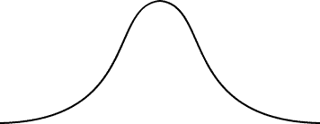
Properties of Normal Distributions
Normal distribution
A continuous probability distribution for a random variable, x.
The most important continuous probability distribution in statistics.
The graph of a normal distribution is called the
normal curve.
x

Slide 7
Properties of Normal Distributions
The mean, median, and mode are equal.
The normal curve is bell-shaped and symmetric about the mean.
The total area under the curve is equal to one.
The normal curve approaches, but never touches the
x-axis as it extends farther and farther away from the
mean.
Total area = 1
μ
x

Slide 8

Properties of Normal Distributions
5. Between μ – σ and μ + σ (in the center of the curve), the graph curves downward. The graph curves upward to the left of μ – σ and to the right of μ + σ. The points at which the curve changes from curving upward to curving downward are called the inflection points.
Inflection points
x
μ + 3σ
μ 3σ μ 2σ
μ σ
μ
μ + σ
μ + 2σ

Slide 9

Means and Standard Deviations
A normal distribution can have any mean and any positive standard deviation.
The mean gives the location of the line of symmetry.
The standard deviation describes the spread of the data.
μ = 3.5
σ = 1.5
μ = 3.5
σ = 0.7
μ = 1.5
σ = 0.7

Slide 10

Example: Understanding Mean and Standard Deviation
1. Which curve has the greater mean?
Solution:
Curve A has the greater mean (The line of symmetry of curve A occurs at x = 15. The line of symmetry of curve B occurs at x = 12.)

Slide 11
Example: Understanding Mean and Standard Deviation
2. Which curve has the greater standard deviation?
Solution:
Curve B has the greater standard deviation (Curve
B is more spread out than curve A.)

Slide 12

Example: Interpreting Graphs
The heights of fully grown white oak trees are normally distributed. The curve represents the distribution. What is the mean height of a fully grown white oak tree?
Estimate the standard deviation.
Solution:
σ = 3.5 (The inflection
μ = 90 (A normal curve is symmetric about the mean)
points are one standard deviation away from the mean)

Slide 13



The Standard Normal Distribution
Standard normal distribution
A normal distribution with a mean of 0 and a standard deviation of 1.
Area = 1
z
3 2 1 0 1 2 3
Any x-value can be transformed into a z-score by using the formula
Value - Mean x - Standard deviation
z

Slide 14
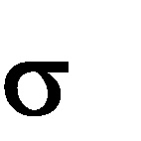



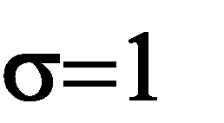

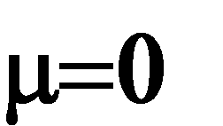
The Standard Normal Distribution
If each data value of a normally distributed random variable x is transformed into a z-score, the result will be the standard normal distribution.
Standard Normal Distribution
Normal Distribution
x -
z
x
z
Use the Standard Normal Table to find the cumulative area under the standard normal curve.

Slide 15
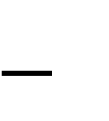


Properties of the Standard Normal Distribution
The cumulative area is close to 0 for z-scores close to z = 3.49.
The cumulative area increases as the z-scores increase.
Area is
close to 0
z = 3.49
z
3
2
1
0
1
2
3

Slide 16

Properties of the Standard Normal Distribution
The cumulative area for z = 0 is 0.5000.
The cumulative area is close to 1 for z-scores close to z = 3.49.
Area is close to 1
z
3
2
1
0
1
2
3
z = 3.49
z = 0
Area is 0.5000

Slide 17

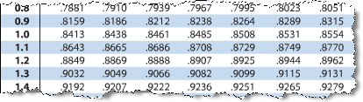
Example: Using The Standard Normal Table
Find the cumulative area that corresponds to a z-score of 1.15.
Solution:
Find 1.1 in the left hand column.
Move across the row to the column under 0.05
The area to the left of z = 1.15 is 0.8749.

Slide 18


Example: Using The Standard Normal Table
Find the cumulative area that corresponds to a z-score of
-0.24.
Solution:
Find -0.2 in the left hand column.
Move across the row to the column under 0.04
The area to the left of z = -0.24 is 0.4052.
Larson/Farber 4th ed

Slide 19
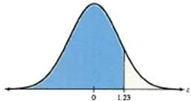
Finding Areas Under the Standard Normal Curve
Sketch the standard normal curve and shade the appropriate area under the curve.
Find the area by following the directions for each case shown.
To find the area to the left of z, find the area that corresponds to z in the Standard Normal Table.
2. The area to the left of z = 1.23 is 0.8907
1. Use the table to find the area for the z-score
19

Slide 20
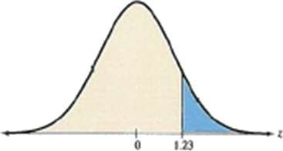

Finding Areas Under the Standard Normal Curve
b. To find the area to the right of z, use the Standard Normal Table to find the area that corresponds to
z. Then subtract the area from 1.
2. The area to the left of z = 1.23 is 0.8907.
3. Subtract to find the area to the right of z = 1.23: 1 0.8907 = 0.1093.
1. Use the table to find the area for the z-score.

Slide 21
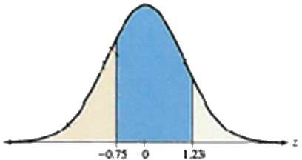

Finding Areas Under the Standard Normal Curve
c. To find the area between two z-scores, find the area corresponding to each z-score in the Standard Normal Table. Then subtract the smaller area from the larger area.
The area to the left of z = 1.23 is 0.8907.
The area to the left of z = 0.75 is 0.2266.
4. Subtract to find the area of the region between the two z-scores:
0.8907 0.2266 = 0.6641.
1. Use the table to find the area for the z-scores.

Slide 22
Example: Finding Area Under the Standard Normal Curve
Find the area under the standard normal curve to the left of z = -0.99.
Solution:
0.1611
0.99 0
From the Standard Normal Table, the area is equal to 0.1611.
z

Slide 23
Example: Finding Area Under the Standard Normal Curve
Find the area under the standard normal curve to the right of z = 1.06.
Solution:
0.8554
1 0.8554 = 0.1446
z
0 1.06
From the Standard Normal Table, the area is equal to 0.1446.

Slide 24
Example: Finding Area Under the Standard Normal Curve
Find the area under the standard normal curve between
z = 1.5 and z = 1.25.
Solution:
0.8944 0.0668 = 0.8276
0.8944
0.0668
z
1.50 0 1.25
From the Standard Normal Table, the area is equal to 0.8276.

Slide 25
Normal Distributions: Finding Probabilities

Slide 26
Probability and Normal Distributions
If a random variable x is normally distributed, you can find the probability that x will fall in a given interval by calculating the area under the normal curve for that interval.
P(x < 600) = Area
μ = 500
σ = 100
x
μ =500 600

Slide 27




Probability and Normal Distributions
Normal Distribution μ = 500 σ = 100
Standard Normal Distribution μ = 0 σ = 1
x
600 500
100
z
1
P(x < 600)
P(z < 1)
x
z
μ =500 600
μ = 0 1
Same Area
P(x < 600) = P(z < 1)

Slide 28

Example: Finding Probabilities for Normal Distributions
A survey indicates that people use their computers an average of 2.4 years before upgrading to a new machine. The standard deviation is 0.5 year. A computer owner is selected at random. Find the probability that he or she will use it for fewer than 2 years before upgrading. Assume that the variable x is normally distributed.

Slide 29




Solution: Finding Probabilities for Normal Distributions
Normal Distribution μ = 2.4 σ = 0.5
Standard Normal Distribution μ = 0 σ = 1
x
2 2.4
P(z < -0.80)
z
0.80
P(x < 2)
0.5
0.2119
x
z
2 2.4
-0.80 0
P(x < 2) = P(z < -0.80) = 0.2119

Slide 30

Example: Finding Probabilities for Normal Distributions
A survey indicates that for each trip to the supermarket, a shopper spends an average of 45 minutes with a standard deviation of 12 minutes in the store. The length of time spent in the store is normally distributed and is represented by the variable x. A shopper enters the store. Find the probability that the shopper will be in the store for between 24 and 54 minutes.

Slide 31






Solution: Finding Probabilities for Normal Distributions
Normal Distribution μ = 45 σ = 12
z
Standard Normal Distribution μ = 0 σ = 1
x - 24 - 45
12
x - 54 - 45
12
-1.75
P(-1.75 < z < 0.75)
1
P(24 < x < 54)
z
0.75
2
0.7734
0.0401
x
z
24 45 54 -1.75 0 0.75
P(24 < x < 54) = P(-1.75 < z < 0.75)
= 0.7734 – 0.0401 = 0.7333

Slide 32

Example: Finding Probabilities for Normal Distributions
Find the probability that the shopper will be in the store more than 39 minutes. (Recall μ = 45 minutes and
σ = 12 minutes)

Slide 33

Solution: Finding Probabilities for Normal Distributions
Normal Distribution μ = 45 σ = 12
Standard Normal Distribution μ = 0 σ = 1
x - 39 - 45
12
P(z > -0.50)
z
-0.50
P(x > 39)
0.3085
x
z
39 45 -0.50 0
P(x > 39) = P(z > -0.50) = 1– 0.3085 = 0.6915

Slide 34
Example: Finding Probabilities for Normal Distributions
If 200 shoppers enter the store, how many shoppers would you expect to be in the store more than 39 minutes?
Solution:
Recall P(x > 39) = 0.6915
200(0.6915) =138.3 (or about 138) shoppers

Slide 35

Example: Using Technology to find Normal Probabilities
Assume that cholesterol levels of men in the United States are normally distributed, with a mean of 215 milligrams per deciliter and a standard deviation of 25 milligrams per deciliter. You randomly select a man from the United States. What is the probability that his cholesterol level is less than 175? Use a technology tool to find the probability.

Slide 36
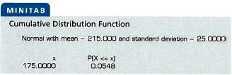

Solution: Using Technology to find Normal Probabilities
Must specify the mean, standard deviation, and the x-
value(s) that determine the interval.

Slide 37
Normal Distributions: Finding Values

Slide 38
Finding the X- Values
Find a z-score given the area under the normal curve
Transform a z-score to an x-value
Find a specific data value of a normal distribution given the probability

Slide 39
Finding values Given a Probability
Earlier, we were given a normally distributed random variable x and we were asked to find a probability.
Here, we will be given a probability and we will be asked to find the value of the random variable
x.
Earlier
x
z
probability
Now

Slide 40
Example: Finding a z-Score Given an Area
Find the z-score that corresponds to a cumulative area of 0.3632.
Solution:
0.3632
z
z 0

Slide 41
Solution: Finding a z-Score Given an Area
Locate 0.3632 in the body of the Standard Normal Table.
The z-score is -0.35.
The values at the beginning of the corresponding row and at the top of the column give the z-score.

Slide 42
Example: Finding a z-Score Given an Area
Find the z-score that has 10.75% of the distribution’s area to its right.
Solution:
1 – 0.1075
= 0.8925
0.1075
z
0 z
Because the area to the right is 0.1075, the cumulative area is 0.8925.

Slide 43
Solution: Finding a z-Score Given an Area
Locate 0.8925 in the body of the Standard Normal Table.
The z-score is 1.24.
The values at the beginning of the corresponding row and at the top of the column give the z-score.

Slide 44
Example: Finding a z-Score Given a Percentile
Find the z-score that corresponds to P₅.
Solution:
The z-score that corresponds to P₅ is the same z-score that corresponds to an area of 0.05.
0.05
z
z
0
The areas closest to 0.05 in the table are 0.0495 (z = -1.65) and 0.0505 (z = -1.64). Because 0.05 is halfway between the two areas in the table, use the z-score that is halfway between -1.64 and -1.65. The z-score is -1.645.

Slide 45
Transforming a z-Score to an x-Score
To transform a standard z-score to a data value x in a given population, use the formula
x = μ + zσ

Slide 46

Example: Finding an x-Value
The speeds of vehicles along a stretch of highway are normally distributed, with a mean of 67 miles per hour and a standard deviation of 4 miles per hour. Find the speeds x corresponding to z-sores of 1.96, -2.33, and 0.
Solution: Use the formula x = μ + zσ
z = 1.96: x = 67 + 1.96(4) = 74.84 miles per hour
z = -2.33: x = 67 + (-2.33)(4) = 57.68 miles per hour
z = 0: x = 67 + 0(4) = 67 miles per hour
Notice 74.84 mph is above the mean, 57.68 mph is below the mean, and 67 mph is equal to the mean.

Slide 47

Example: Finding a Specific Data Value
Scores for a civil service exam are normally distributed, with a mean of 75 and a standard deviation of 6.5. To be eligible for civil service employment, you must score in the top 5%. What is the lowest score you can earn and still be eligible for employment?
Solution:
An exam score in the top 5%
1 – 0.05
= 0.95
0
5%
is any score above the 95th percentile. Find the z-score that corresponds to a cumulative area of 0.95.
z
?
x
75
?

Slide 48
Solution: Finding a Specific Data Value
From the Standard Normal Table, the areas closest to 0.95 are 0.9495 (z = 1.64) and 0.9505 (z = 1.65).
Because 0.95 is halfway between the two areas in the table, use the z-score that is halfway between 1.64 and
1.65. That is, z = 1.645.
5%
z
0
1.645
x
75
?

Slide 49
Solution: Finding a Specific Data Value
Using the equation x = μ + zσ
x = 75 + 1.645(6.5) ≈ 85.69
5%
z
0
1.645
x
75
85.69
The lowest score you can earn and still be eligible for employment is 86.

Slide 50
Sampling Distributions and the Central Limit Theorem

Slide 51
What to Learn ?
Find sampling distributions and verify their properties
Interpret the Central Limit Theorem
Apply the Central Limit Theorem to find the probability of a sample mean

Slide 52
Sampling Distributions
Sampling distribution
The probability distribution of a sample statistic.
Formed when samples of size n are repeatedly taken from a population.
e.g. Sampling distribution of sample means

Slide 53
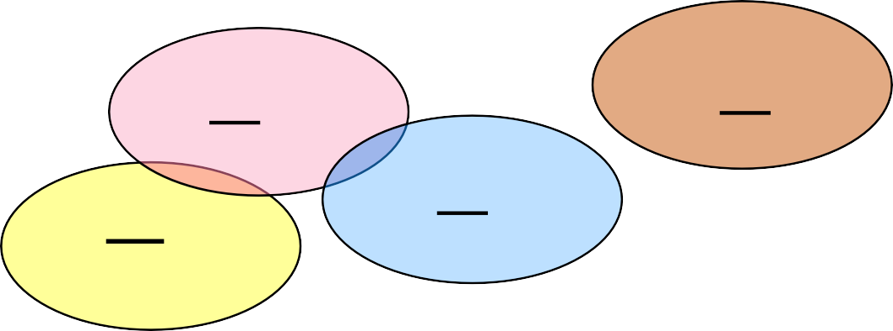
Sampling Distribution of Sample Means
Population with μ, σ
Sample 3
Sample 5
x₃
x₅
Sample 1
Sample 4
x₄
x₁
Sample 2
x
2
The sampling distribution consists of the values of the sample means, x₁, x₂ , x₃ , x₄ , x₅ ,...

Slide 54







Properties of Sampling Distributions of Sample Means
1. The mean of the sample means, population mean μ.
x
_{x} , is equal to the
2. The standard deviation of the sample means, _{x} , is equal to the population standard deviation, σ divided by the square root of the sample size, n.
x
n
Called the standard error of the mean.

Slide 55









Example: Sampling Distribution of Sample Means
The population values {1, 3, 5, 7} are written on slips of paper and put in a box. Two slips of paper are randomly selected, with replacement.
a. Find the mean, variance, and standard deviation of the population.
Solution:
x
Mean:
4
N
₎2
(x
Variance:
2
5
N
Standard Deviation:
5 2.236

Slide 56
Example: Sampling Distribution of Sample Means
b. Graph the probability histogram for the population values.
Solution:
P(x)
Probability Histogram of Population of x
0.25
All values have the same probability of being selected (uniform distribution)
Probability
x
1
3 5
Population values
7

Slide 57
Example: Sampling Distribution of Sample Means
c. List all the possible samples of size n = 2 and calculate the mean of each sample.
Solution:
x x
Sample Sample
1, 1
1, 3
1, 5
1, 7
3, 1
3, 3
3, 5
3, 7
1
2
3
4
2
3
4
5
5, 1
5, 3
5, 5
5, 7
7, 1
7, 3
7, 5
7, 7
3
4
5
6
4
5
6
7
These means form the sampling distribution of sample means.

Slide 58
Example: Sampling Distribution of Sample Means
d. Construct the probability distribution of the sample means.
Solution:
x | f | Probability
1 | 1 | 0.0625
2 | 2 | 0.1250
3 | 3 | 0.1875
4 | 4 | 0.2500
5 | 3 | 0.1875
6 | 2 | 0.1250
7 | 1 | 0.0625

Slide 59









Example: Sampling Distribution of Sample Means
e. Find the mean, variance, and standard deviation of the sampling distribution of the sample means.
Solution:
The mean, variance, and standard deviation of the 16 sample means are:
5
2
4
2
x
2.5 2.5 1.581
x
x
These results satisfy the properties of sampling distributions of sample means.
5 2.236
^{x} n 2 2
4
1.581
x

Slide 60
Example: Sampling Distribution of Sample Means
f. Graph the probability histogram for the sampling distribution of the sample means.
Solution:
P(x)
Probability Histogram of Sampling Distribution of x
0.25
0.20
0.15
0.10
0.05
The shape of the graph is symmetric and bell shaped. It approximates a normal distribution.
Probability
x
2
3 4 5 6 7
Sample mean

Slide 61
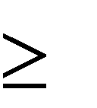
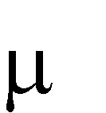
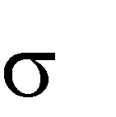

The Central Limit Theorem
1. If samples of size n 30, are drawn from any population with mean = and standard deviation = ,
x
then the sampling distribution of the sample means approximates a normal distribution. The greater the sample size, the better the approximation.
^{x} x _{x} x _{x} x_{x}
x
x
x x _{x}
x

Slide 62
The Central Limit Theorem
2. If the population itself is normally distributed,
x
the sampling distribution of the sample means is normally distribution for any sample size n.
^{x} x _{x} x _{x} x_{x}
x
x
x _{x}
x
x

Slide 63



The Central Limit Theorem
In either case, the sampling distribution of sample means has a mean equal to the population mean.
x
The sampling distribution of sample means has a variance equal to 1/n times the variance of the population and a standard deviation equal to the population standard deviation divided by the square
root of n.
2
2
x
Variance
n
Standard deviation (standard error of the mean)
x
n

Slide 64



The Central Limit Theorem
1. Any Population Distribution 2. Normal Population Distribution
Distribution of Sample
Means, n ≥ 30
Distribution of Sample Means,
(any n)

Slide 65
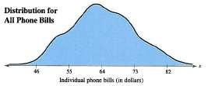

Example: Interpreting the Central Limit Theorem
Phone bills for residents of a city have a mean of $64 and a standard deviation of $9. Random samples of 36 phone bills are drawn from this population and the mean of each sample is determined. Find the mean and standard error of the mean of the sampling distribution.
Then sketch a graph of the sampling distribution of sample means.

Slide 66





Solution: Interpreting the Central Limit Theorem
The mean of the sampling distribution is equal to the population mean
64
x
The standard error of the mean is equal to the population standard deviation divided by the square root of n.
9
^{x} n 36
1.5

Slide 67




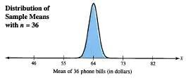
Solution: Interpreting the Central Limit Theorem
Since the sample size is greater than 30, the sampling distribution can be approximated by a normal distribution with
64
1.5
x
x

Slide 68


Example: Interpreting the Central Limit Theorem
The heights of fully grown white oak trees are normally distributed, with a mean of 90 feet and standard deviation of 3.5 feet. Random samples of size 4 are drawn from this population, and the mean of each sample is determined. Find the mean and standard error of the mean of the sampling distribution. Then sketch a graph of the sampling distribution of sample means.

Slide 69



Solution: Interpreting the Central Limit Theorem
The mean of the sampling distribution is equal to the population mean
90
x
The standard error of the mean is equal to the population standard deviation divided by the square root of n.
3.5
^{x} n 4
1.75

Slide 70


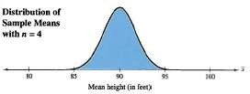
Solution: Interpreting the Central Limit Theorem
Since the population is normally distributed, the sampling distribution of the sample means is also normally distributed.
90
1.75
x
x

Slide 71






Probability and the Central Limit Theorem
To transform x to a z-score
Value-Mean
x
x
z
x
Standard Error
x
n

Slide 72
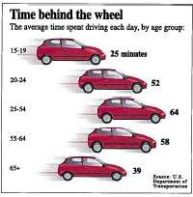
Example: Probabilities for Sampling Distributions
The graph shows the length of time people spend driving each day. You randomly select 50 drivers age 15 to 19. What is the probability that the mean time they spend driving each day is between 24.7 and 25.5 minutes? Assume that σ = 1.5 minutes.

Slide 73



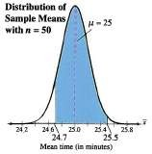
Solution: Probabilities for Sampling Distributions
From the Central Limit Theorem (sample size is greater than 30), the sampling distribution of sample means is approximately normal with
1.5
^{x} n 50
25
0.21213
x

Slide 74






Solution: Probabilities for Sampling Distributions
Normal Distribution μ = 25 σ = 0.21213
z₁
P(24.7 < x < 25.5)
Standard Normal Distribution μ = 0 σ = 1
-1.41
P(-1.41 < z < 2.36)
x - 24.7 - 25
n
x - 25.5 - 25
n
1.5 50
z
2.36
2
1.5
50
0.9909
0.0793
-1.41 0
x
z
24.7 25 25.5
2.36
P(24 < x < 54) = P(-1.41 < z < 2.36)
= 0.9909 – 0.0793 = 0.9116

Slide 75

Example: Probabilities for x and x
A bank auditor claims that credit card balances are normally distributed, with a mean of $2870 and a standard deviation of $900.
1. What is the probability that a randomly selected credit card holder has a credit card balance less than
$2500?
Solution:
You are asked to find the probability associated with a certain value of the random variable x.

Slide 76



Solution: Probabilities for x and x
Normal Distribution μ = 2870 σ = 900
Standard Normal Distribution μ = 0 σ = 1
x -
2500 - 2870
900
P(x < 2500)
z
-0.41
P(z < -0.41)
0.3409
x
z
2500 2870 -0.41 0
P( x < 2500) = P(z < -0.41) = 0.3409

Slide 77





Example: Probabilities for x and x
2. You randomly select 25 credit card holders. What is the probability that their mean credit card balance is less than $2500?
Solution:
You are asked to find the probability associated with a sample mean x.
900
^{x} n 25
2870
180
x

Slide 78


Solution: Probabilities for x and x
Normal Distribution μ = 2870 σ = 180
Standard Normal Distribution μ = 0 σ = 1
x -
900
n 25
z
2500 - 2870
-2.06
P(z < -2.06)
P(x < 2500)
0.0197
x
z
2500 2870 -2.06
0
P( x < 2500) = P(z < -2.06) = 0.0197

Slide 79
Solution: Probabilities for x and x
There is a 34% chance that an individual will have a balance less than $2500.
There is only a 2% chance that the mean of a sample of 25 will have a balance less than $2500 (unusual event).
It is possible that the sample is unusual or it is possible that the auditor’s claim that the mean is
$2870 is incorrect.

Slide 80
Thank you

